Slide 1
IST 659 Final Project
Gabe Herz, Shane Halpin, Pranjal Singh, Daniel Beim

Slide 2
Project Overview
Fantasy sports are seeing increased popularity in the US and across the world. For a sport like basketball, which is one of the most globally popular sports, billions of fans tune in and follow the premier basketball leagues and their favorite star players. As a result, there is a new opportunity to capture more fan interest in fantasy basketball.
This project looks to build a Fantasy Basketball Player management system that can query specific information that was previously unavailable to fantasy sport players.
This system will help solve many issues faced by fantasy players and fantasy advice givers as it will make the player statistics and information easier to store, maintain and access. It will also increase the efficiency of building a fantasy team, covering more data than what is traditionally used in fantasy basketball leagues, with the same ease of access.
Notes:
Shane

Slide 3
Specifications
Entity Relationship Data Requirements
Conceptual Model
Logical Model
SQL Up/Down Script
User Stories via SQL select examples
User Interface Design
Notes:
Shane

Slide 4
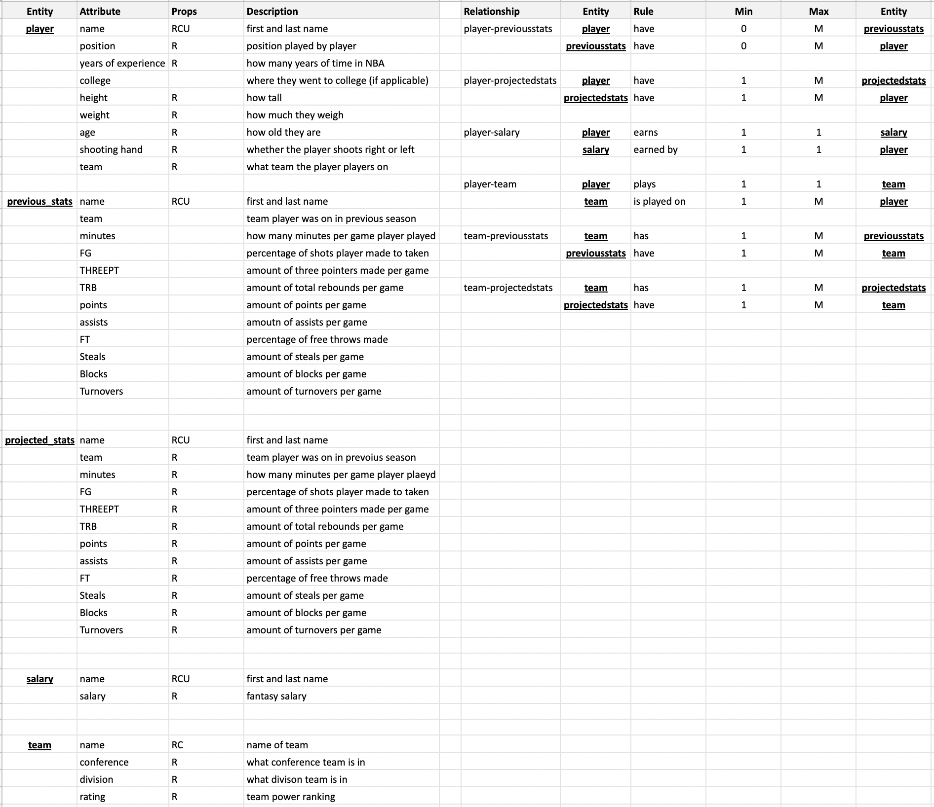
Entity Relationship Data Requirements
Notes:
Gabe

Slide 5
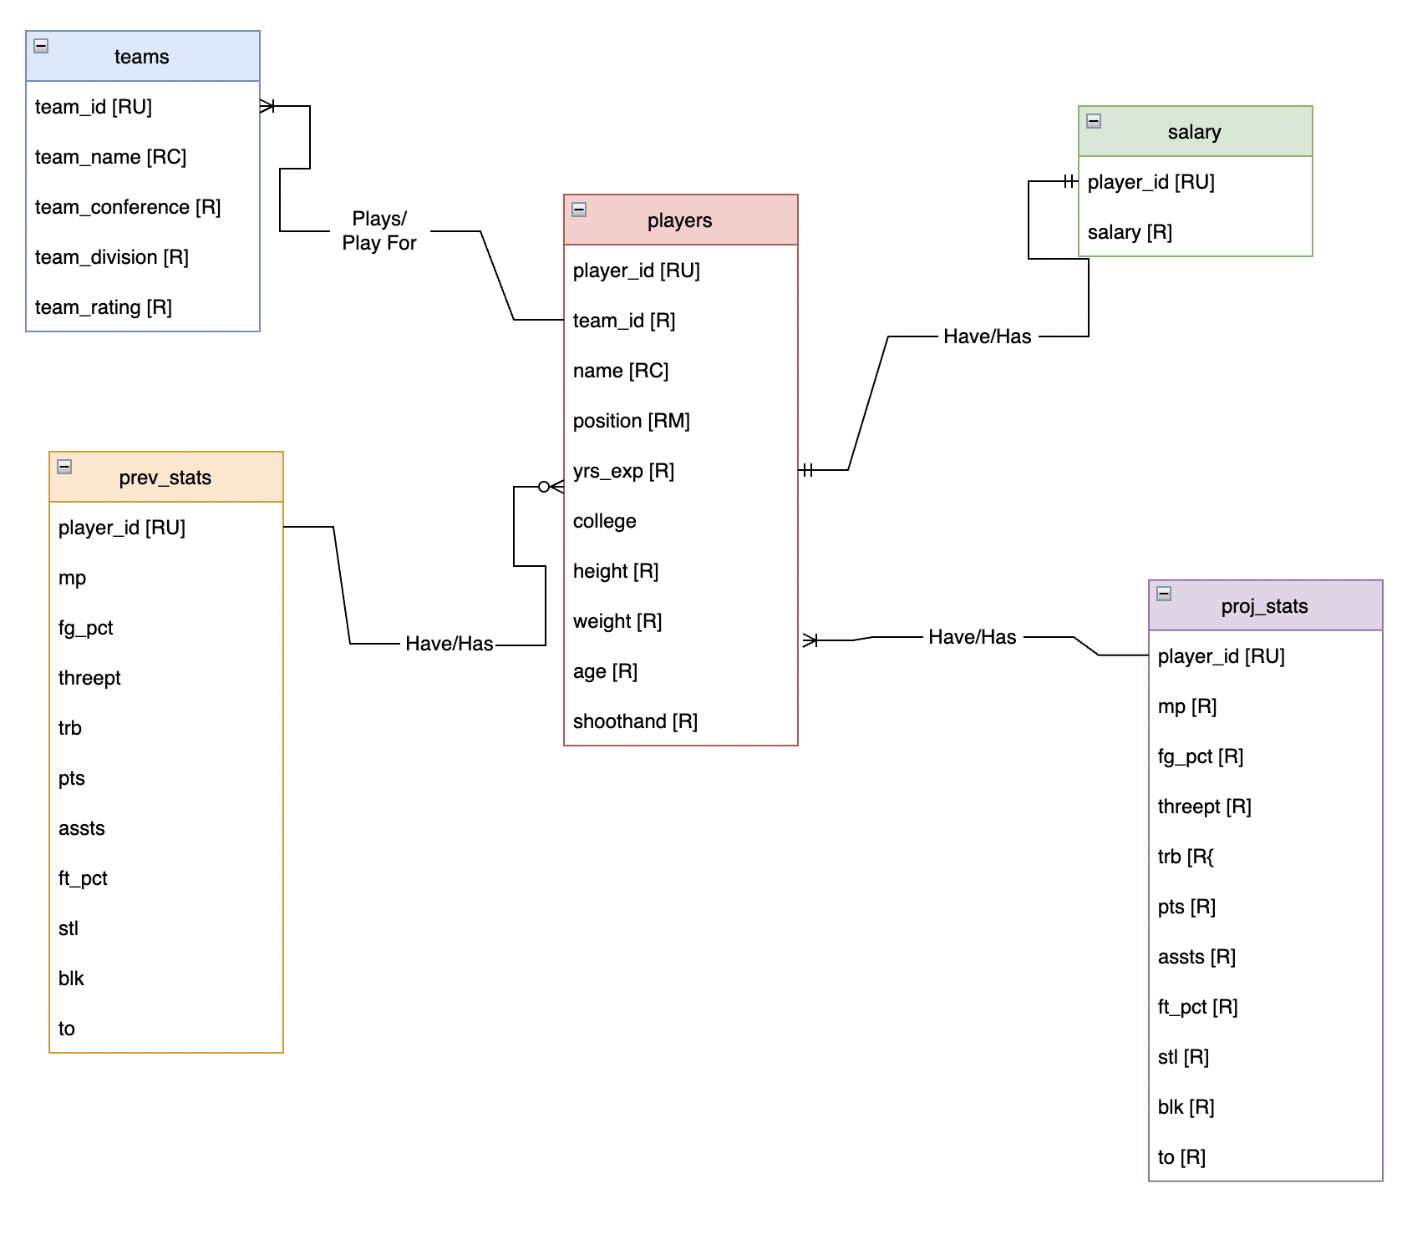
Conceptual Model
Notes:
Shane

Slide 6
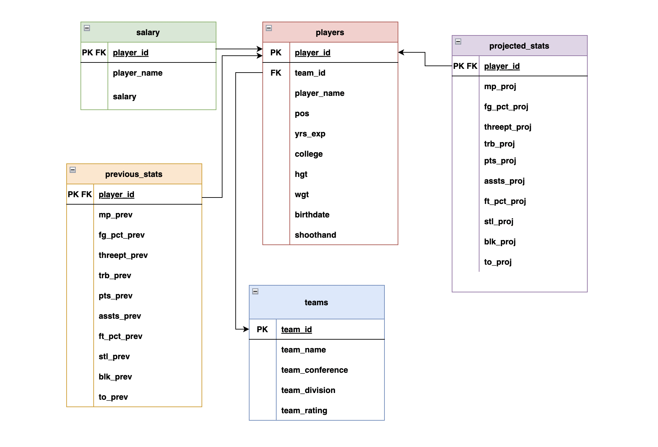
Logical Model
Notes:
Dan

Slide 7
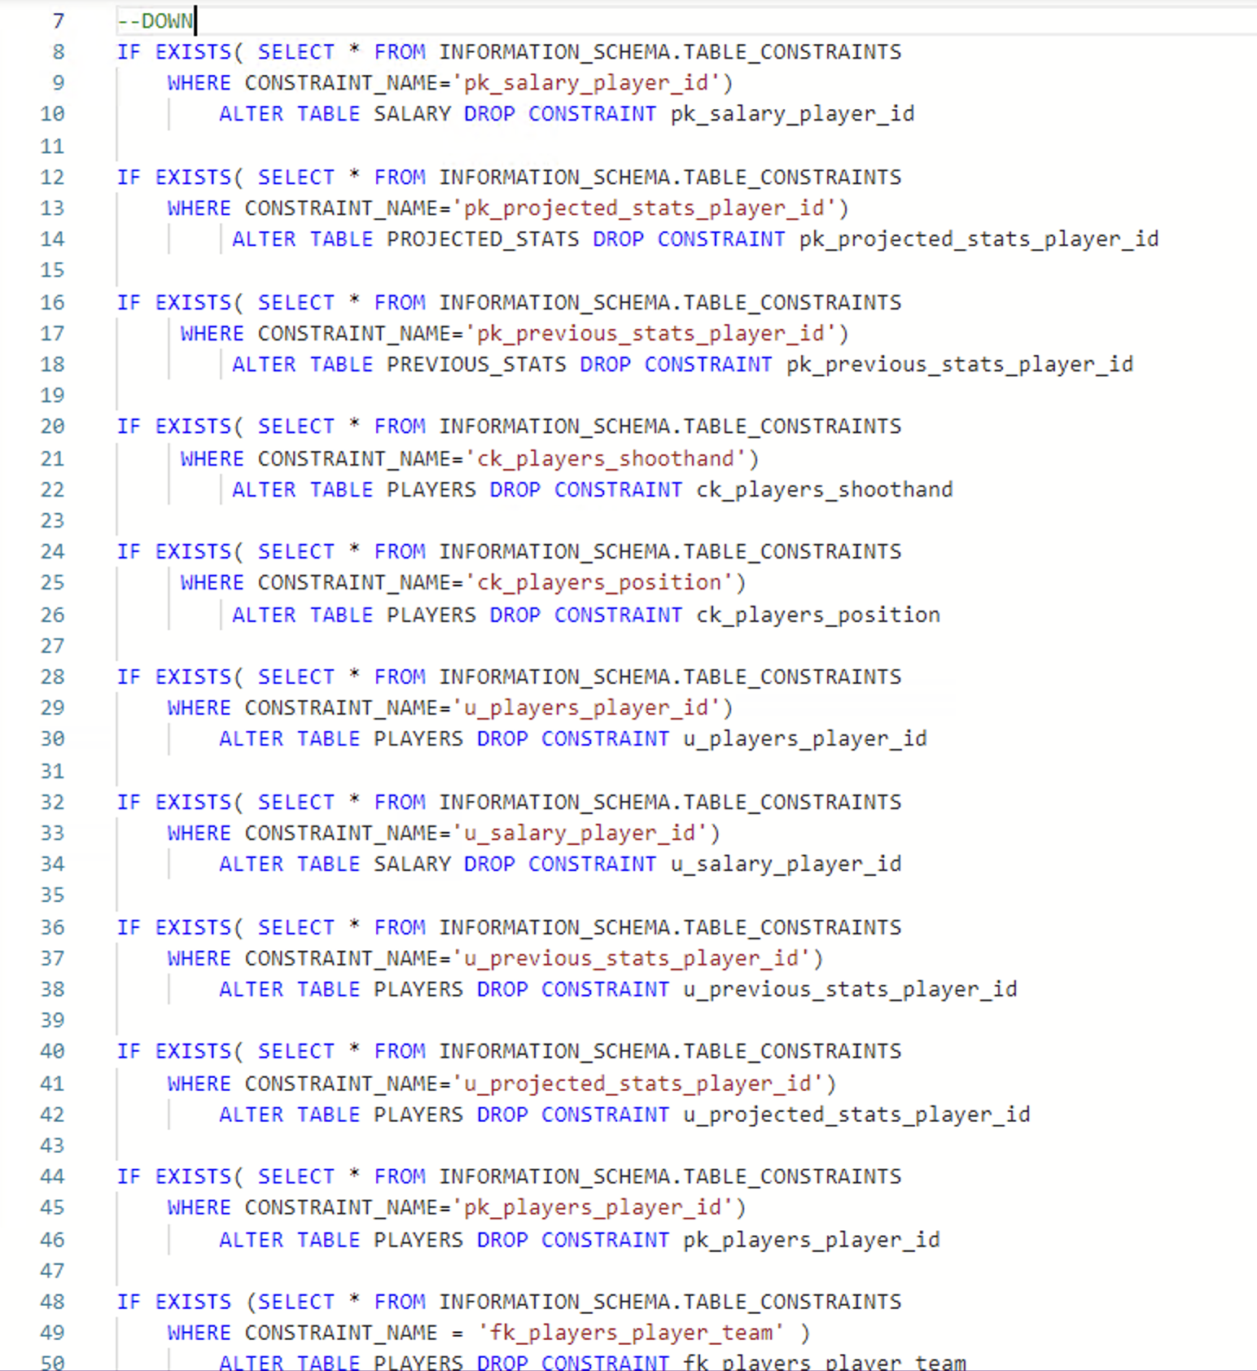
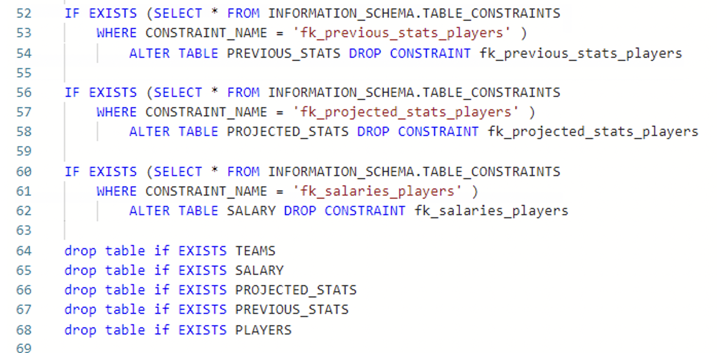
SQL Down Script
Notes:
PJ

Slide 8
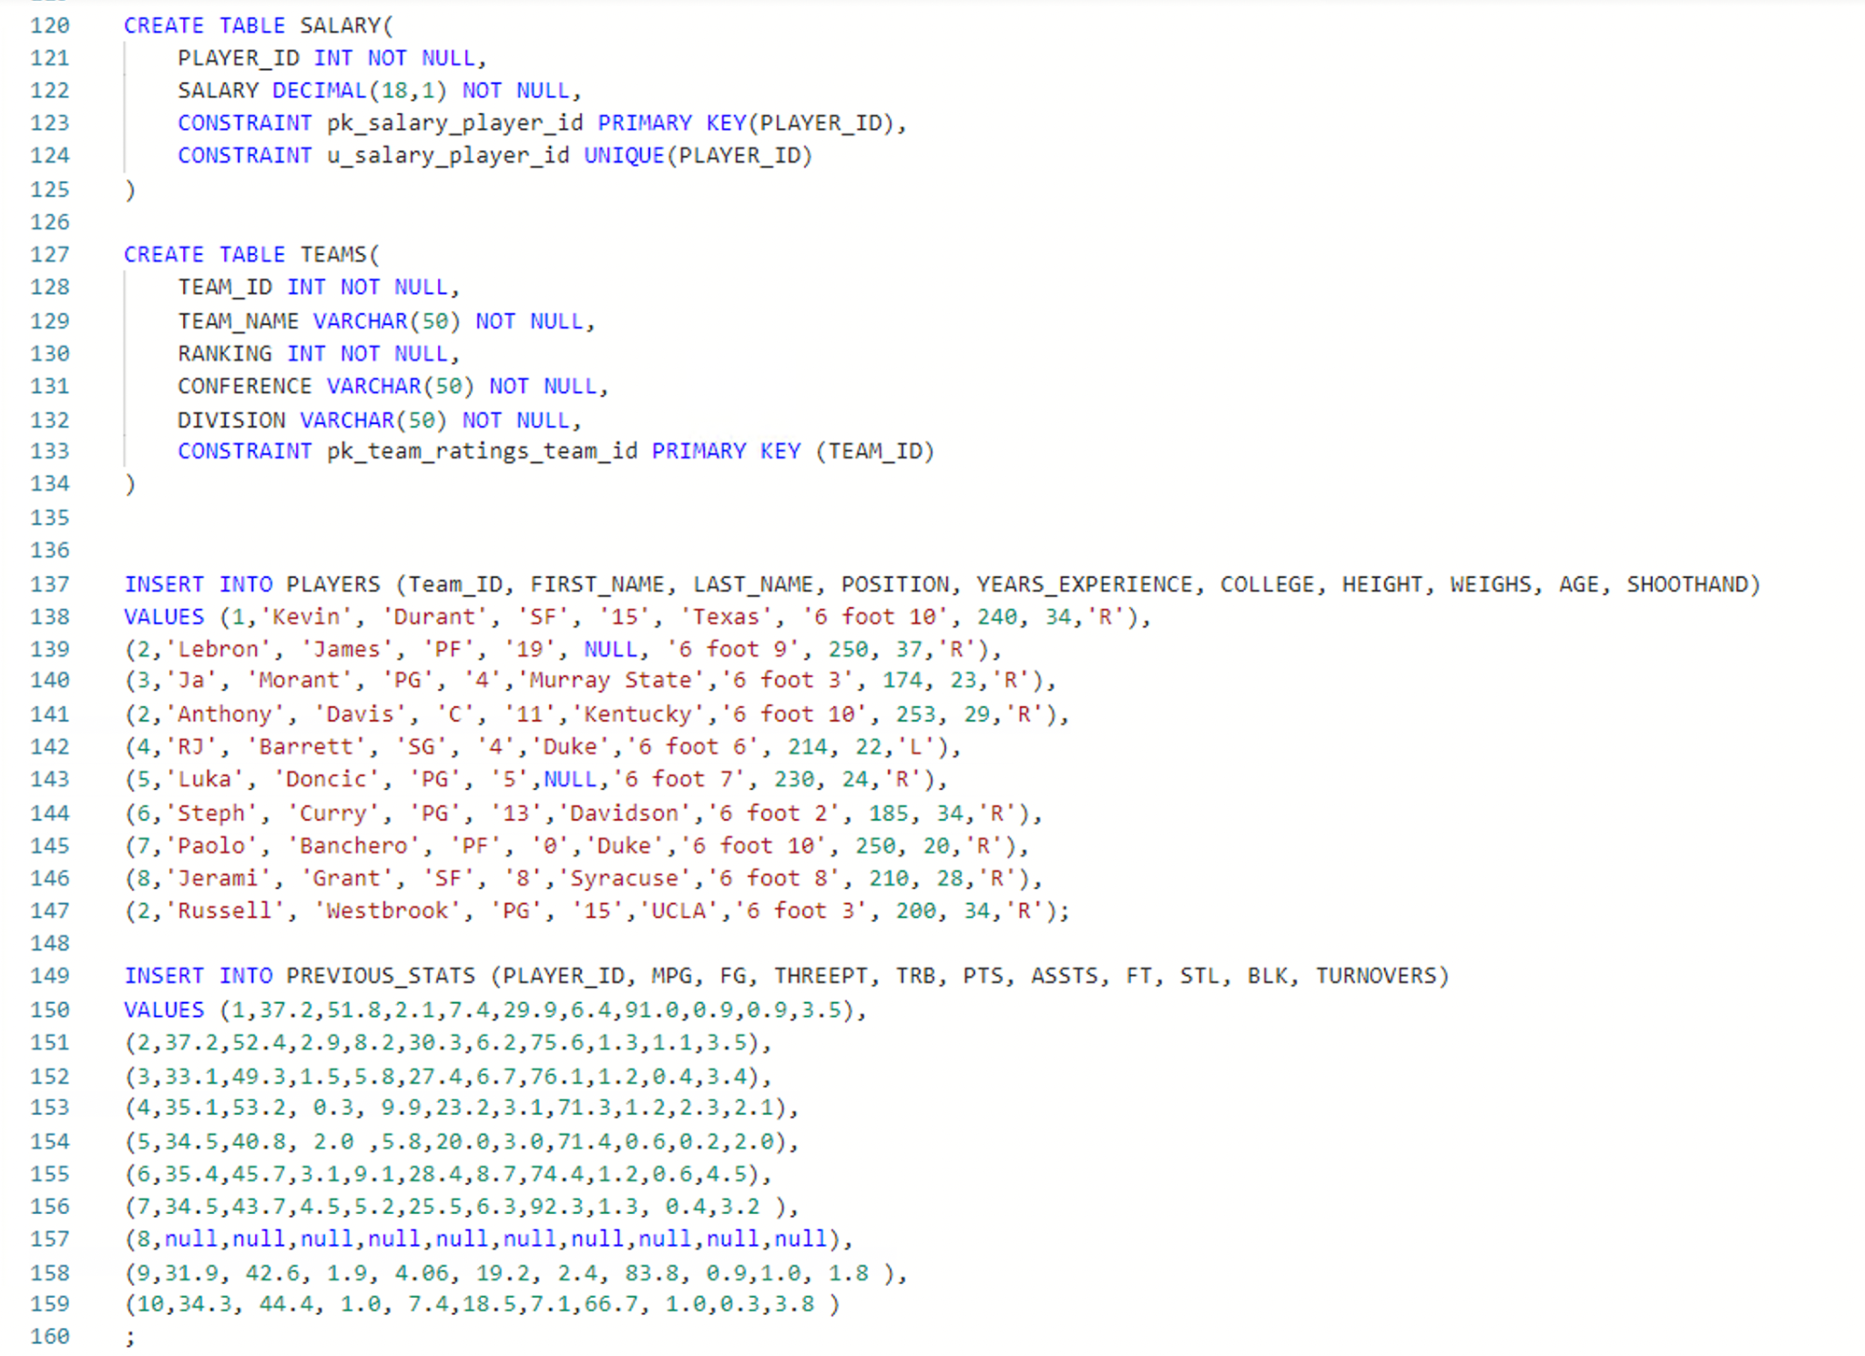
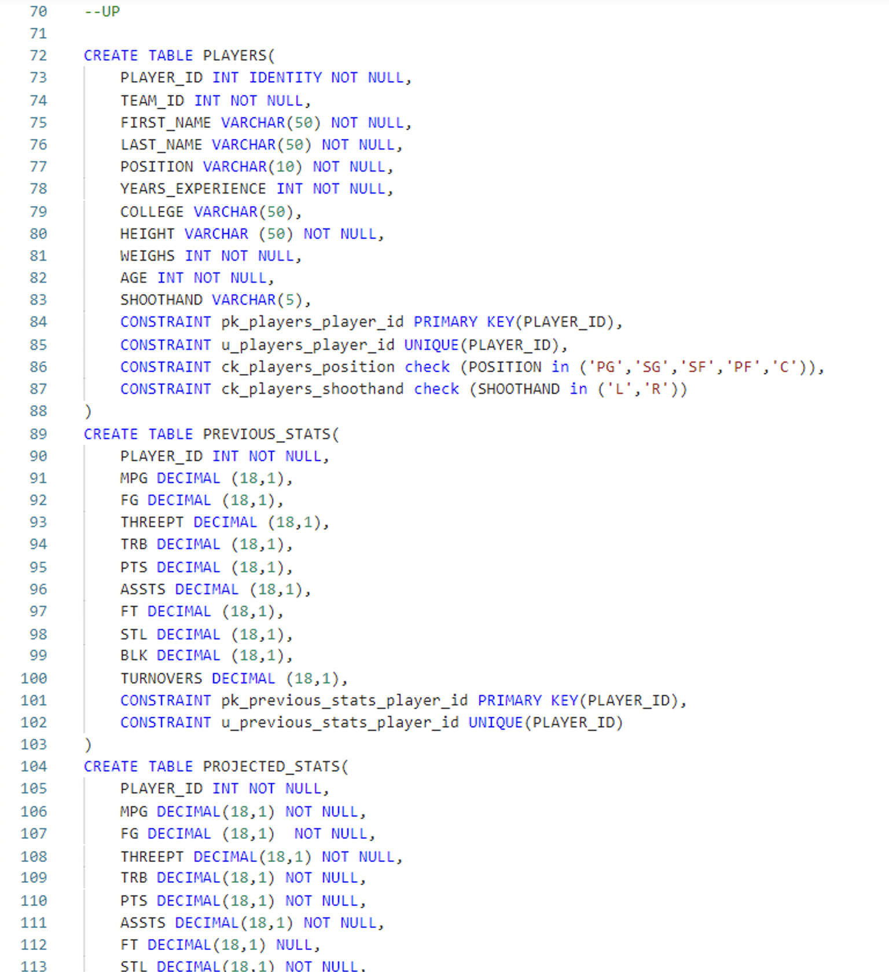
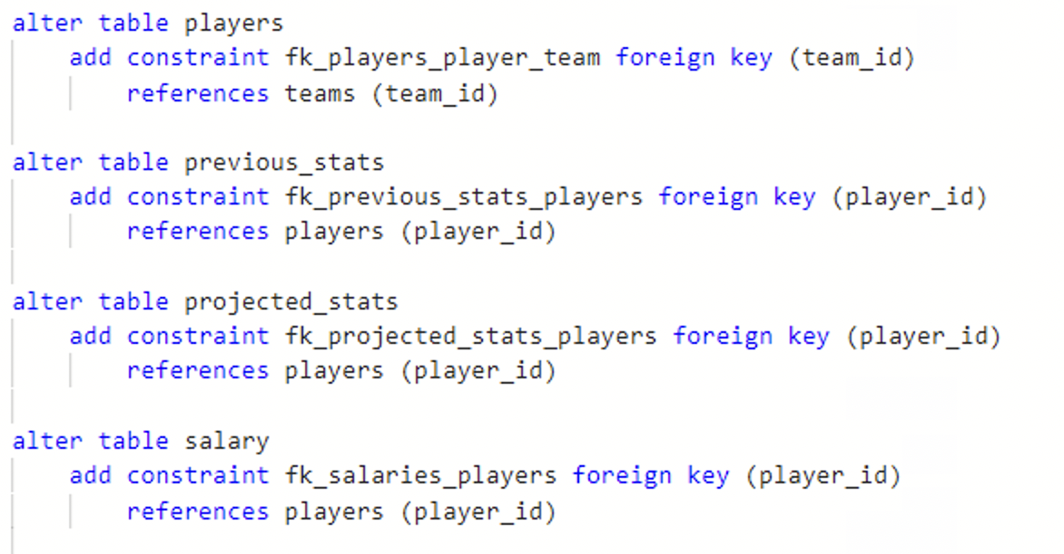
SQL UP Script
Notes:
PJ

Slide 9
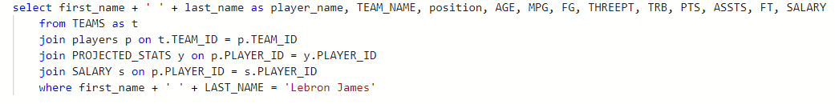
User Story Example 1
As a user, I want to see a specific player’s information, his projected stats for the upcoming season, and the cost of drafting him (salary) in order to receive a better understanding of his value for my fantasy team and when I should consider drafting him. In this situation, the player I am looking at is Lebron James.
Notes:
Dan

Slide 10
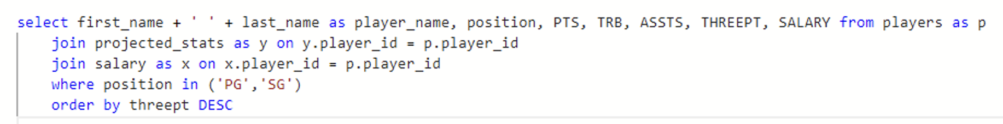
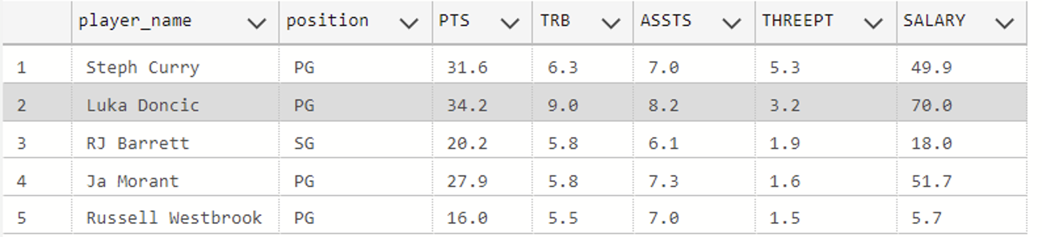
User Story Example 2
As a user, I want to see the names, projected points, rebounds, assists, three-pointers, and salary of all players who are guards
I would also like the output to be filtered by three pointers made, as I am trying to add a three point shooter to my team
Notes:
Gabe

Slide 11
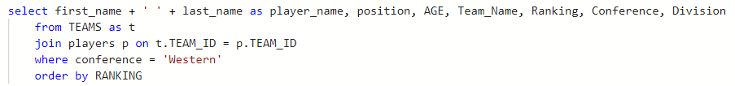
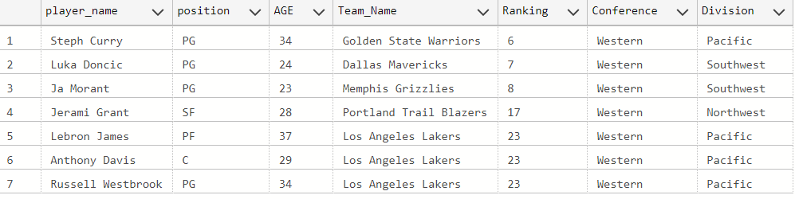
User Story Example 3
As a user, I want to get a better understanding of the players’ relationships to the teams they play for and how this may affect their performance. In this example, I am looking to find all players on Western Conference teams, ordered by the strength of the team they play for (Ranking).
Notes:
Shane

Slide 12

Application Layout
Notes:
PJ

Slide 13
Thanks for Listening !

